Slide 1
Monitoring the mental health of first responders has become an increasingly important issue
+8% disclosing suicidal thoughts
Increase in suicidal ideation 2023 to 2024-2025
Suicidal Ideation 11% higher in Specialty Stations

Slide 2
Turnover Intentions
US Firefighters in 2024-2025 (N=864)
21% intend to quit the Fire Service
17% intend to quit the industry
PTSD and Burnout
N=864
42% experiencing burnout
%
%
17% report PTSD
%
%
Increase from 2023-2025 in burnout & PTSD
Burnout & PTSD higher in Specialty Stations

Slide 3
Mental Health Outcomes by Org Type & Service Area (US Firefighters 2024-2025)
N=864
Suicidal thoughts & PTSD highest in Career Departments, lowest in Volunteers Departments
Suicidal thoughts, PTSD, & Burnout highest in Urban Service Areas

Slide 4
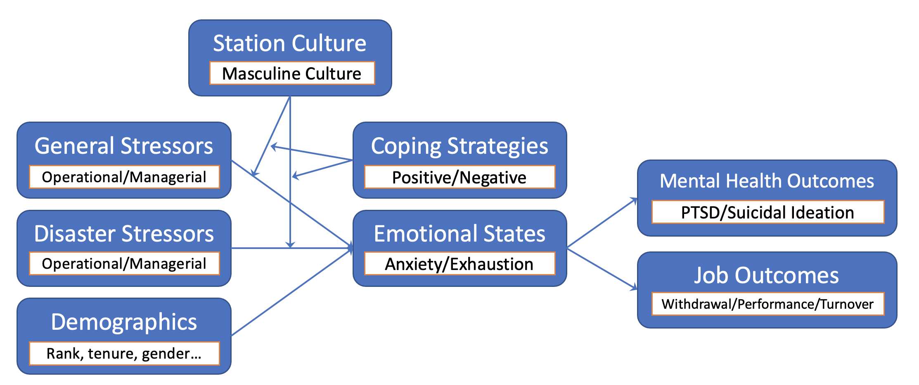
Hypothetical Model

Slide 5
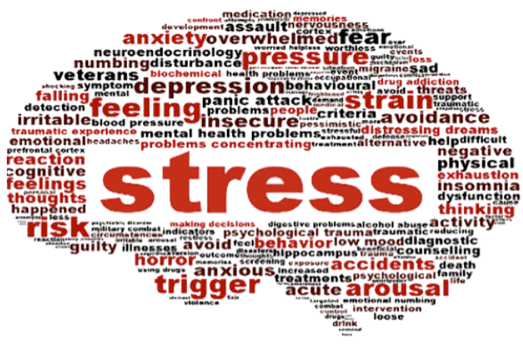
Firefighter Stressors: Most Impactful
Please rate how often you have experienced any of the following, and what type of impact it has had, in the past two months

Slide 6
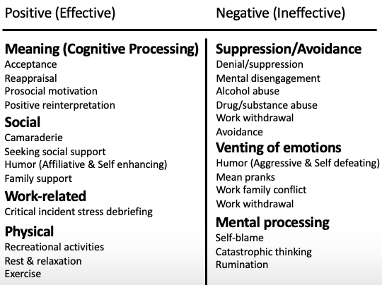
Often Coping with Stress Using Negative Mechanisms

Slide 7
That are often used due to cultural and social stigmas such as…
Fire Service Culture: Negative Attitudes Towards Emotional Expression
In strong hyper masculine cultures, expressing emotions and talking about issues considered to be a sign of weakness or incompetence. This reduces firefighters willingness to seek help, making stressors at work more difficult to manage.

Slide 8
The Difference (Interaction Effects) A
Notes:
The main takeaway from the graph is that negative emotional expression norms increase negative coping behaviors (alcohol and drug use), especially when the firefighter is experiencing higher levels of critical incident stress.

Slide 9
The Difference (Interaction Effects) B
Coping via Alcohol & Drug Use increases suicidal ideation, especially when the firefighter is experiencing higher stress levels.
Notes:
The main takeaway from the graph is that alcohol and drug use as a coping mechanism increases suicidal ideation, especially when the firefighter is experiencing higher critical incident stress levels.

Slide 10
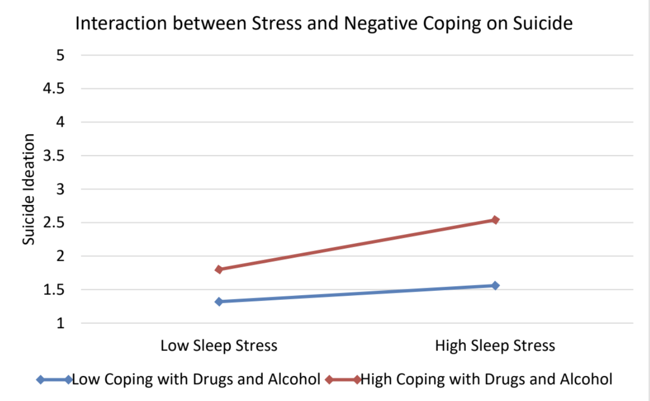
Interaction Effects
Notes:
The main takeaway from the graph is that using drugs and alcohol as a coping strategy increases suicide ideation, especially when the firefighter is experiencing higher levels of stress.
This means that as stress increases, those who utilize drugs and alcohol as a coping strategy reporting higher levels of suicide ideation.

Slide 11
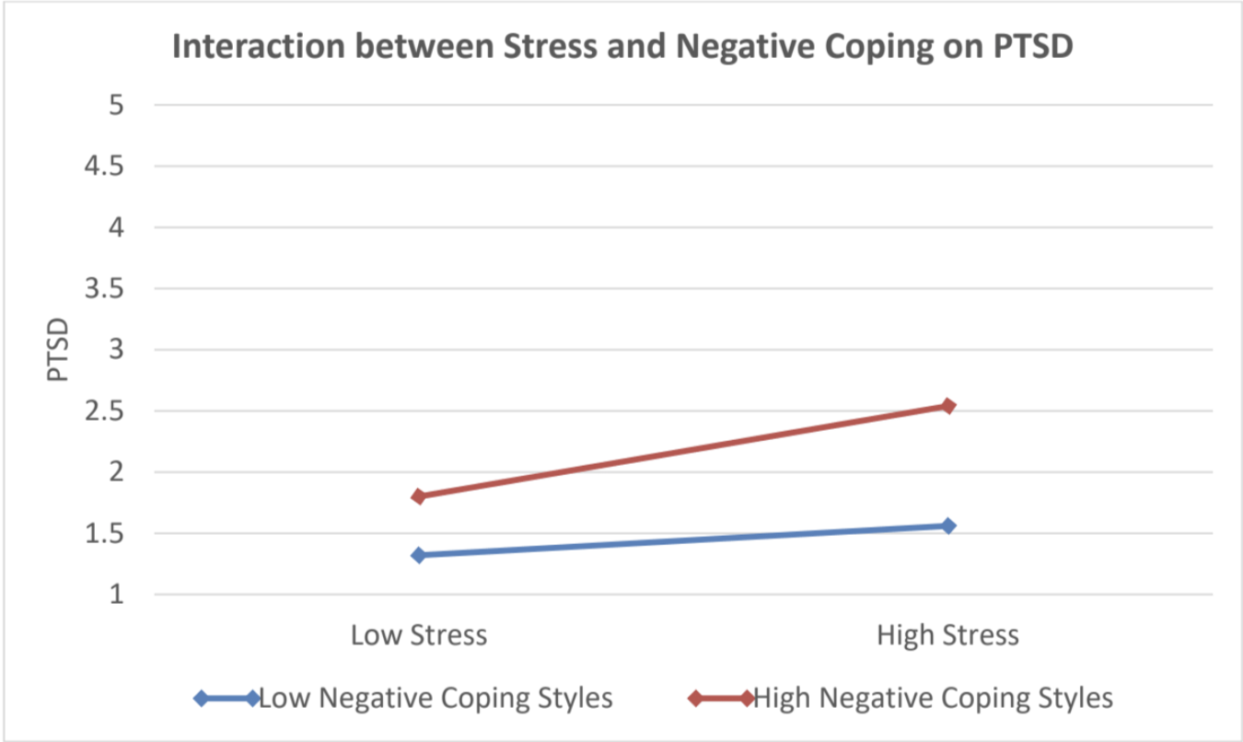
The Difference (Interaction Effects)
Notes:
The main takeaway from the graph is that using negative coping strategies increases PTSD, especially when the firefighter is experiencing higher levels of stress

Slide 12
Firefighter Stressors: Most Impactful by Service Area
Critical Incidents drive more strain amongst Urban firefighters, while suburban and rural firefighters are more concerned with staffing
Job skills concerns are the top stressor for firefighters in underdeveloped service areas (more than sleep)

Slide 13
Firefighter Stressors: Most Impactful by org Type

Slide 14
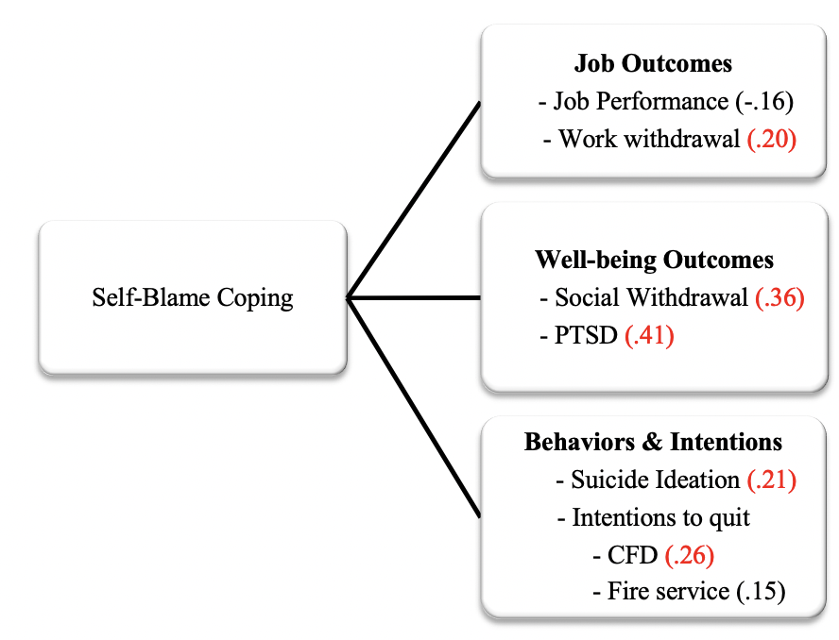
Correlations
Notes:
INTERACTION EFFECTS ALSO SHOW using negative coping strategies increases PTSD, especially when the firefighter is experiencing higher levels of stress.

